Slide 1
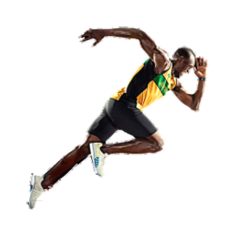
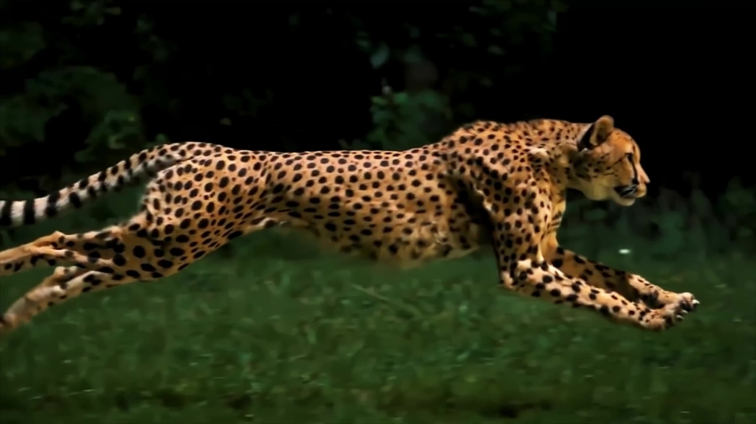
Usain Bolt
The fastest man on earth

Slide 2
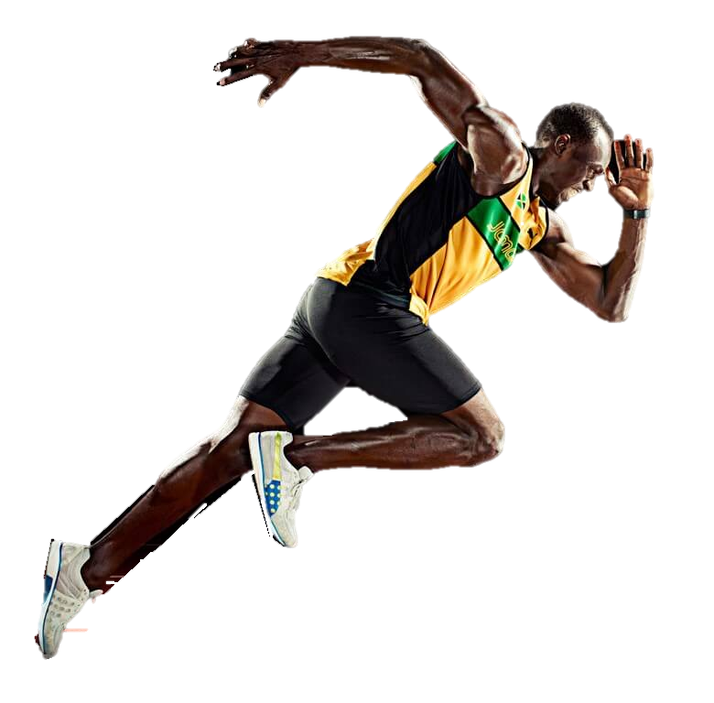
GIFTED RUNNER
He wanted to be a cricketer
But destiny had other plans because, he is a gifted sprinter
He was identified by his school coach he advised bolt to work on his sprinting abilities
He soon rose to fame by age 15 he became the youngest world-gold medalist ever
And the road to history begins!!!
Notes:
COACH--- Pablo McNeil a former Olympic sprint athlete(primary coach), and Dwayne Jarrett (school coach)

Slide 3
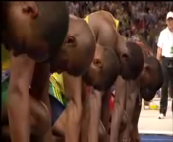
THE MOMENT

Slide 4
IS THE JOURNEY THAT SMOOTH ????????
No………. it was indeed not smooth, he had injury problems – scoliosis, a curvature of the spine, affecting his hamstrings
Extreme nervous breakdown before the international tournament
Multiple injuries all through his career did compel him to postpone his trainings at certain stages of his career.
“The workload I had leading up to the Olympics and even at the 2015 world championships meant there was so much pressure and stress that it just wasn’t fun anymore,” Bolt was quoted as saying by the Guardian.
Notes:
Bolt's 200 m win made him the youngest world-junior gold medallist ever.^{[34]} The expectation from the home crowd had made him so nervous that he had put his shoes on the wrong feet, although he realized the mistake before the race began^{[35]}. However, it turned out to be a revelatory experience for Bolt, as he vowed never again to let himself be affected by pre-race nerves

Slide 5
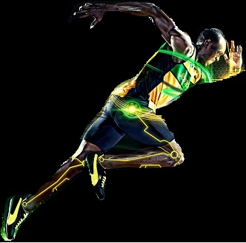
TIME SPOKE
The first athlete to achieve gold in all the 3 formats(100/200/4*100 relay format)
Only sprinter to win Olympic 100m m and 200 m titles at three consecutive Olympics(2008, 2012 and 2016)
An eight-time Olympic gold medalist and a eleven-time World Champion.
Notes:
He won consecutive World Championship 100 m, 200 m and 4 × 100 metres relay gold medals from 2009 to 2015

Slide 6
HISTORY CONTINUES…………….
Bolt became the first sprinter to break both records at the same Olympics
He has twice broken the 200 meters world record, setting 19.30 in 2008 and 19.19 in 2009)
He was honored with BBC Overseas Sports Personality of the Year for 3 times & Laureus World Sportsman of the Year for 4 times.
Notes:
He won consecutive World Championship 100 m, 200 m and 4 × 100 metres relay gold medals from 2009 to 2015o
both 100m and 200 m records in 2008 Beijing olympics

Slide 7

Beijing Olympics
Legend’s Treasure
the 19G
(100Meters,200M,
400M relay format)
2008
Berlin
World C
2009
Daegu World C
100: Gold, 9.69
200: Gold,19.30
100: Gold, 9.58
200: Gold,19.19
4x100: Gold,37.31
2011
London
olymipics
2012
200: Gold,19.40
4x100: Gold,37.04
Moscow
World C
100: Gold, 9.63
200: Gold,19.32
4x100: Gold,36.84
2013
Beijing Olympics
2015
Rio d janerio
100: Gold, 9.77
200: Gold,19.66
4x100: Gold,37.36
100: Gold, 9.79
200: Gold,19.55
4x100: Gold,37.36
2016
100: Gold, 9.81
200: Gold,19.78
4x100: Gold,37.31

Slide 8
